Slide 1


A Presentation on Tour Guide
Developed by: Aditya Ranjan Pandey

Slide 2
Introduction
Tourist Guide is a Android application that generally based on tour guide system that shows list of Delhi tourist places.
Its shows that place address and visiting day and time.
Purpose:
 Purpose behind this application is making a tourist guide app that will be helpful for such people who wants to visit all places of Delhi without need of any guide person.

Slide 3
Purposed System
In current system, Every tourist need a guide to visit places of Delhi and every people not bear to cost of tourist guide.
Another thing is we also provide map and website of that place to gather all information about that places.

Slide 4
Continue…
Proposed System
This application keeps the data in a centralized way which is available to all the users simultaneously.
Ease for user to make use of this application not complicated design or things.
Scope
Time saving.
Money saving.
Show list of all Visiting places of Delhi.
You can gather all information about visiting places.

Slide 5
Project Profile
Project Title | Tourist Guide
Front End Tools | Android Studio
Language | Java and XML
Developed by | Aditya Ranjan Pandey
Submitted to
University

Slide 6
Functionality
List of Tourist places of Delhi
Show that place address and images.
Show opening and closing time with days
Also have a button to show map of that place
Special button to show website of particular place.

Slide 7
Requirements
For Android user:
Hardware requires:
RAM : minimum 512 MB RAM
MEMORY: minimum 50mb space
Software requires:
OS: API level higher or kitkat version

Slide 8
Continue…
For Development:
Hardware requires:
RAM: minimum 3GB RAM
Harddisk : minimum 100GB
Software requires:
Android Studio for App development
Photo editing tool for logo.
Web browser for surfing web service

Slide 9
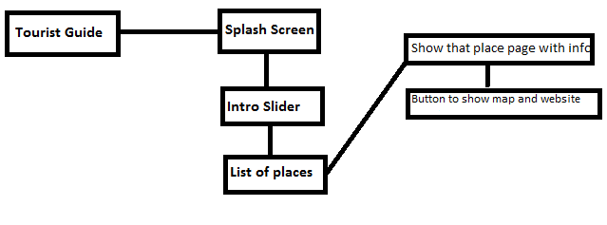
Diagrams:-

Slide 10
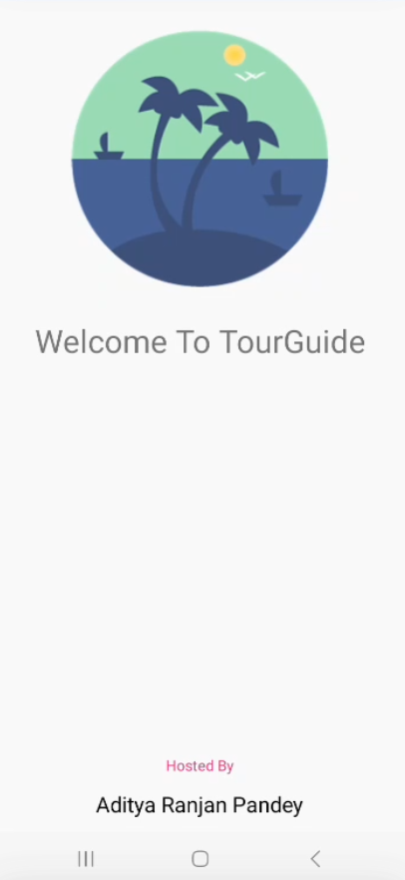
Screen Shot-Splash Screen


Slide 11
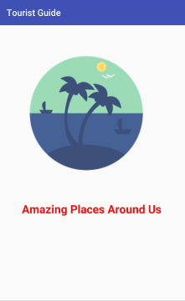
Screenshot- Intro Slider

Slide 12
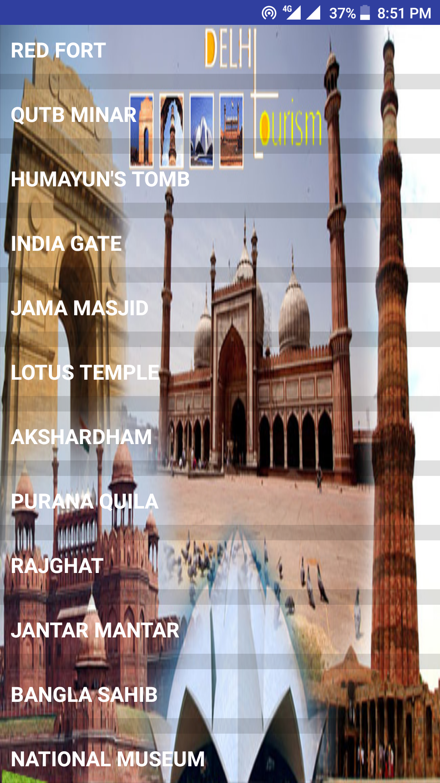
List of places:

Slide 13
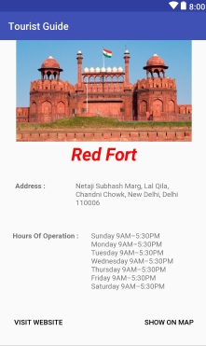
Cont..

Slide 14
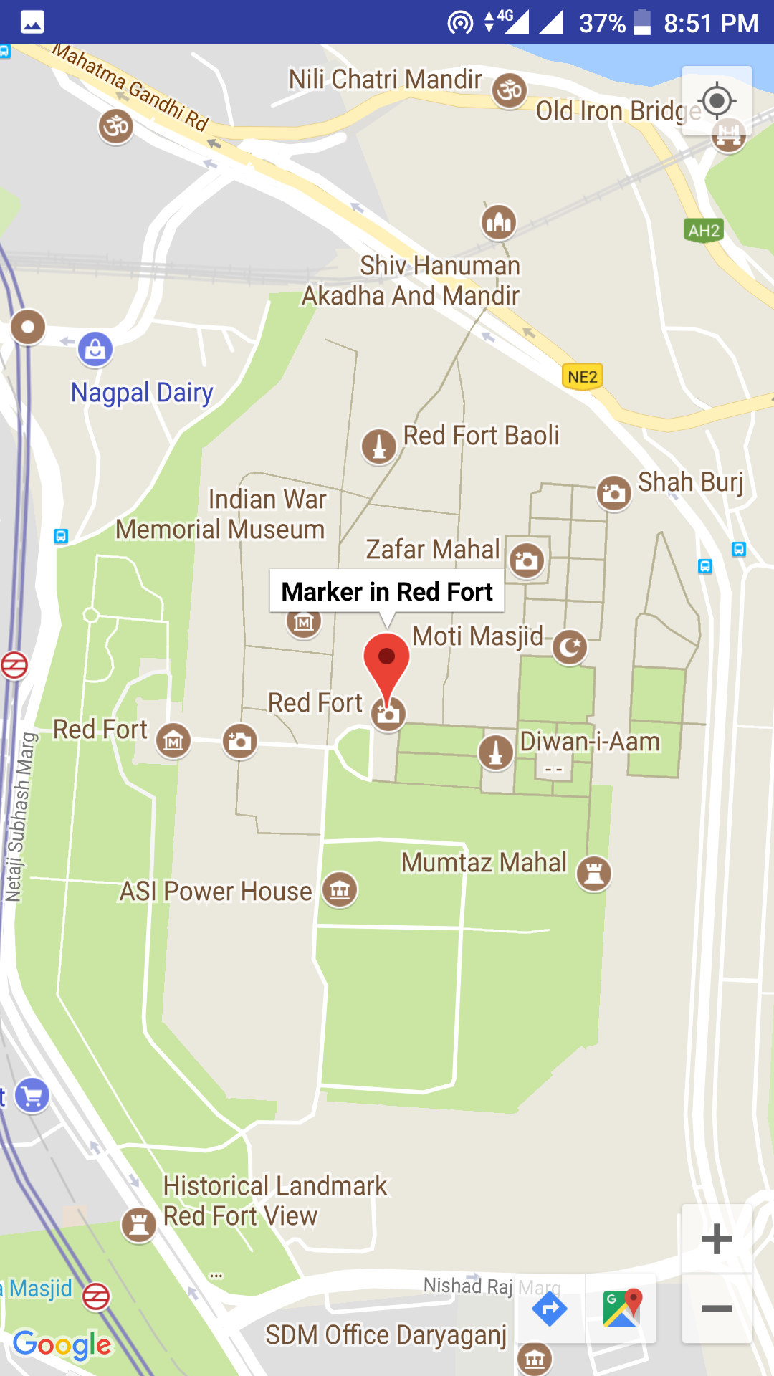
Map

Slide 15
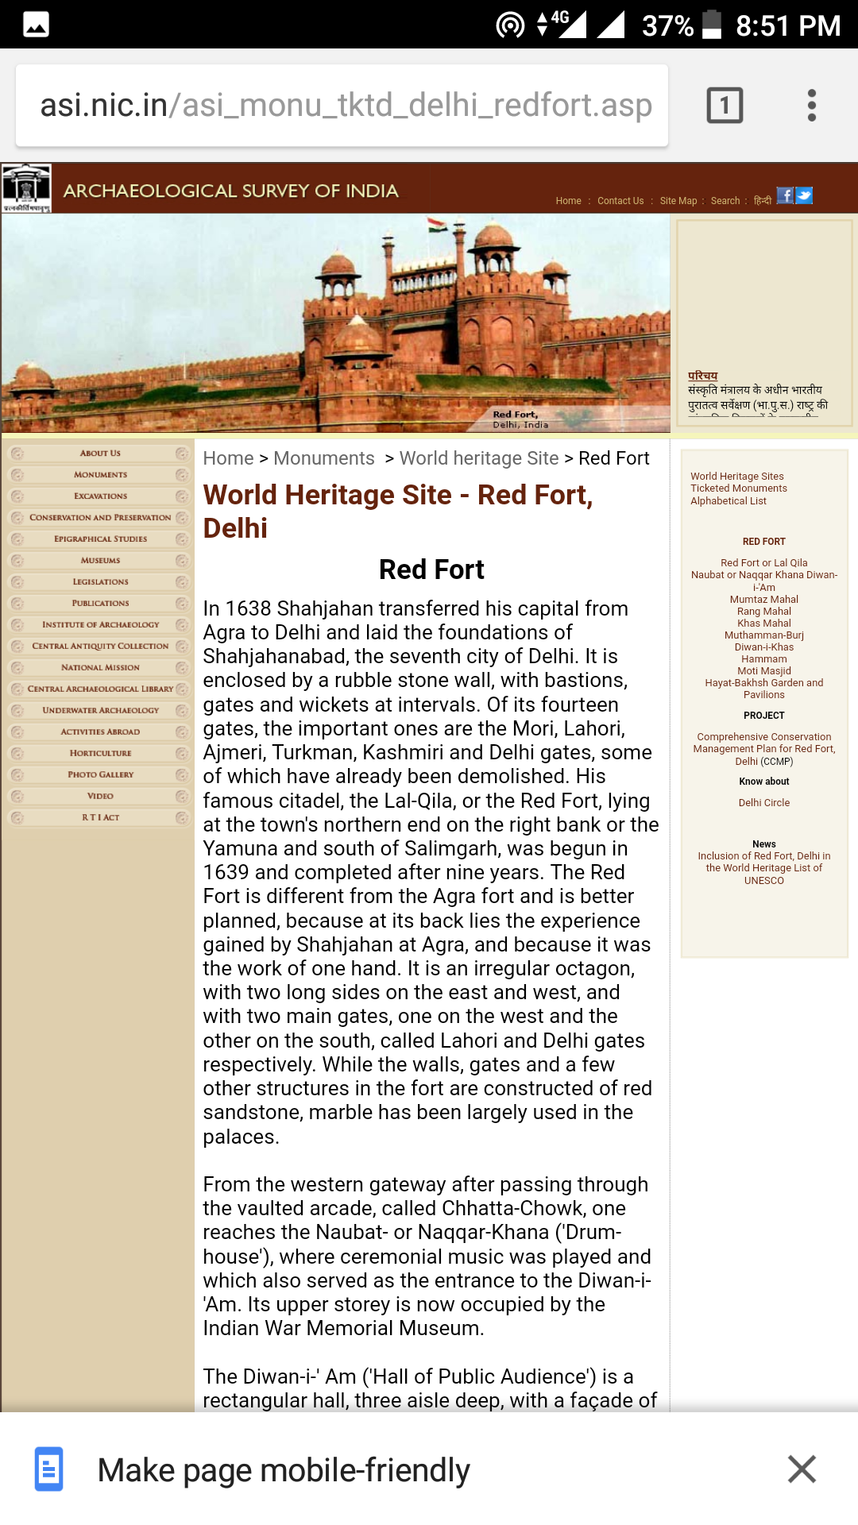
Website:

Slide 16
Conclusion
Overall we have created application in focus of travel purpose app that will be helpful to new person that have not much information about Delhi places.
Implemented website and map features to gather extra information about particular place.

Slide 17
Bibliography
Links:
www.google.co.in
developer.android.com
www.stackoverflow.com

Slide 18

Thank You

